Slide 1
The Testimony of Christ
John 5:31-47

Slide 2
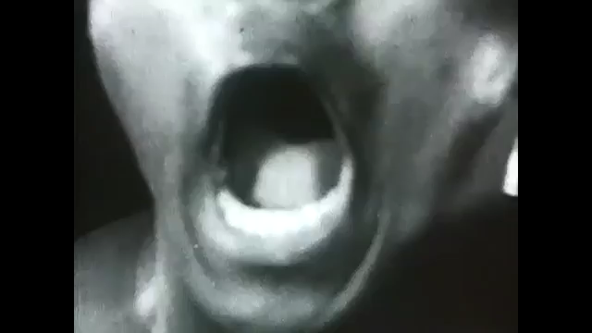

Slide 3
John 5:31-47 – The Testimony of Christ
Concern Acknowledged
The Witness of John
The Evidence of the Works
The Witness of the Father
The Evidence of Hypocrisy
The Accusation of Moses

Slide 4
Concern Acknowledged John 5:31
When someone questions your faith in Christ, will you acknowledge and try to address their concerns?

Slide 5
The Witness of John John 5:23-35
If they don’t believe you, can you point them to a witness that they do or have respected.
If you help person to see believers they do respect, it may make them more willing to hear the gospel message.

Slide 6
The Evidence of the Works John 5:36
You cannot do miracles, but you have work that the Father has given you
As you work well you give evidence that Jesus is working through you.
The only way anyone will listen is if you do the work that God has appointed.

Slide 7
The Witness of the Father John 5:37-39
The very words of God in scripture testify about Jesus being God’s Son.
The very words of Old Testament scripture prove that Jesus is God.

Slide 8
The Evidence of Hypocrisy John 5:39-44
He doesn’t condemn them because they fail to understand the scriptures about Him, but because they refuse to believe
Their failure to accept proves that they have no love for God.
There is none so blind as he who refuses to see.

Slide 9
The Accusation of Moses John 5:45-47
Moses will accuse them because they refused to believe what he wrote about Jesus.
When Paul wrote, “All scripture is God breathed,” the Old Testament was what he was referring to 2 Timothy 3:16-17
When Peter wrote, the prophets spoke for God, it was the Old Testament prophets. 2 Peter 1:19-21

Slide 10
The Accusation of Moses John 5:45-47
We are not saved by Scripture, we know our savior through Scripture.
Some are accused because of neglecting to read and learn the Scriptures.

